Slide 1

Data Analytics in Business
Linear Regression
Sridhar Narasimhan, Ph.D
Professor
Scheller College of Business
Steps in Regression Analysis

Slide 2



Lessons in this Module
Steps in Regression Analysis
A Real Estate example
Notation
R², Adjusted R²
Simple Regression (One Predictor Variable) Using R
Multiple Regression
R², Adjusted R² from Multiple Regression
Common Problems and Fixes in Linear Regression

Slide 3

Steps in Regression Analysis
Statement of the problem
Using regression for:
Diagnostic,
Predictive, or
Prescriptive analytics?
Selection of potentially relevant response and explanatory variables
Data collection
Internal data external data, purchased data, experiments, etc.
Adapted from Chatterjee, S., & Hadi, A. S. (2013). Regression Analysis by Example (5th ed.). Somerset: W iley.

Slide 4
Steps in Regression Analysis (cont’d)
Choice of fitting method:
Ordinary least squares (OLS),
Generalized least squares,
Maximum likelihood,
Etc.
Model fitting
Model validation (diagnostics)
Refine the model & iterate from step 3
Use of the model
Adapted from Chatterjee, S., & Hadi, A. S. (2013). Regression Analysis by Example (5th ed.). Somerset: W iley.

Slide 5
Business Examples
Y - Dependent Variable
X - Independent Variable(s)
Used car price
Sales
Time taken to repair a product
Product added to shopping cart?
Starting salary of new employee
Sale price of house
Will customer default?
Will customer churn?
odometer reading, age of car, condition advertisement spending
experience of technician in years ratings, price
work experience, years of education square feet, # of bedrooms, location credit balance, income, age
length of contract, age of customer

Slide 6
Quiz (True/False)
Could a variable, say price, be either a dependent or an independent
variable?
Answer: TRUE. Depends on the purpose of your model; see where price
appears in examples #1 and #4 in the previous slide.
A variable that takes binary values (pass/fail or true/false) cannot be a dependent variable.
Answer: FALSE. We do use 0/1 dependent variables in logistic regression
models; #7 in the previous slide is one example.

Slide 7
Data Analytics in Business
Linear Regression
Sridhar Narasimhan, Ph.D
Professor
Scheller College of Business
Real Estate Pricing Example

Slide 8
Linear Regression: A Sample Problem
Assume that you need to sell your house
You want to predict the listing price based on how other houses are listed in the market
How would you approach this task?
A typical approach is to ask realtors:
Realtors often will use “comparables” (i.e., recent sales of houses in your neighborhood) and somehow come up with a suggested sale price
However, you want to be more analytical in your approach
You have access to recent actual home sales in your city
You’d like to know what are the impacts of factors such as lotsize, # of bedrooms, # of bathrooms, etc., on the price
Could you use linear regression to help you get a “better” estimate of the listing price?

Slide 9
Use Housing Dataframe in Ecdat Package in R
This data set is a sample of the real estate transactions in one city
It is a cross-section of 546 home prices (from 1987) in the city of Windsor in
Canada
Alternatively, you could collect house prices from websites or scrape them from the web

Slide 10
str(Housing)
'data.frame': 546 obs. of 12 variables:
$ price: num 42000 38500 49500 60500 61000 66000 66000 69000 83800 88500 ...
$ lotsize: num 5850 4000 3060 6650 6360 4160 3880 4160 4800 5500 ...
$ bedrooms: num 3 2 3 3 2 3 3 3 3 3 ...
$ bathrms: num 1 1 1 1 1 1 2 1 1 2 ...
$ stories: num 2 1 1 2 1 1 2 3 1 4 ...
$ driveway: Factor w/ 2 levels "no","yes": 2 2 2 2 2 2 2 2 2 2 ...
$ recroom: Factor w/ 2 levels "no","yes": 1 1 1 2 1 2 1 1 2 2 ...
$ fullbase: Factor w/ 2 levels "no","yes": 2 1 1 1 1 2 2 1 2 1 ...
$ gashw: Factor w/ 2 levels "no","yes": 1 1 1 1 1 1 1 1 1 1 ...
$ airco: Factor w/ 2 levels "no","yes": 1 1 1 1 1 2 1 1 1 2 ...
$ garagepl: num 1 0 0 0 0 0 2 0 0 1 ...
$ prefarea: Factor w/ 2 levels "no","yes": 1 1 1 1 1 1 1 1 1 1 ...

Slide 11
The First 10 Records in Housing
Housing Dataset in the Ecdat package in R
price | lotsize | bedrooms | bathrms | stories | driveway | recroom | fullbase | gashw | airco | garagepl | prefarea
42000 | 5850 | 3 | 1 | 2 | yes | no | yes | no | no | 1 | no
38500 | 4000 | 2 | 1 | 1 | yes | no | no | no | no | 0 | no
49500 | 3060 | 3 | 1 | 1 | yes | no | no | no | no | 0 | no
60500 | 6650 | 3 | 1 | 2 | yes | yes | no | no | no | 0 | no
61000 | 6360 | 2 | 1 | 1 | yes | no | no | no | no | 0 | no
66000 | 4160 | 3 | 1 | 1 | yes | yes | yes | no | yes | 0 | no
66000 | 3880 | 3 | 2 | 2 | yes | no | yes | no | no | 2 | no
69000 | 4160 | 3 | 1 | 3 | yes | no | no | no | no | 0 | no
83800 | 4800 | 3 | 1 | 1 | yes | yes | yes | no | no | 0 | no
88500 | 5500 | 3 | 2 | 4 | yes | yes | no | no | yes | 1 | no

Slide 12
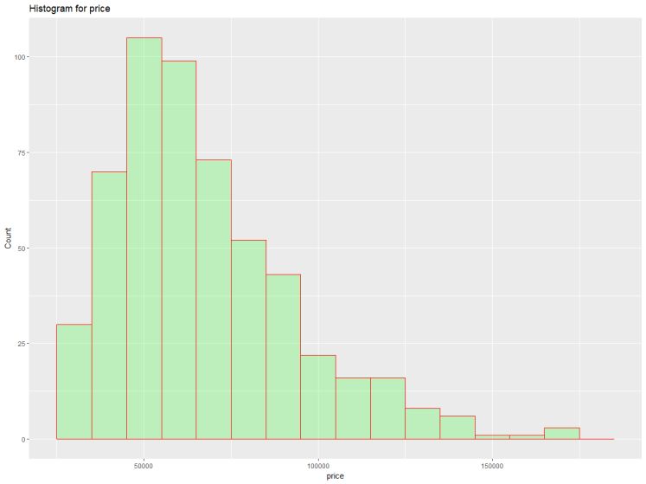
Histogram of House Prices
Median: 62,000
Mean: 68,122
count
price

Slide 13
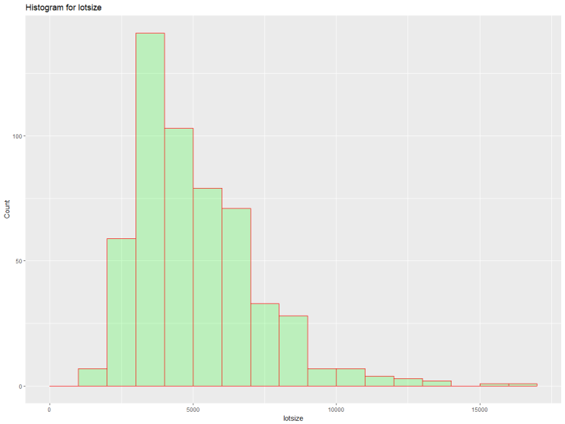
Histogram of lotsize
Median: 4,600
Mean: 5,150
count
lotsize

Slide 14
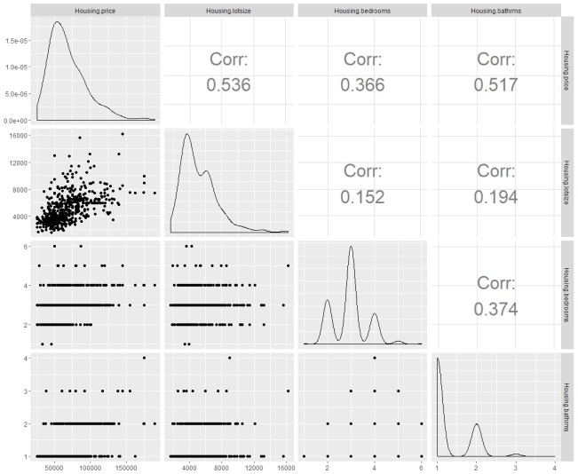
Correlation Matrix
price
lotsize
bedrooms
bathrooms
price
lotsize
bedrooms
bathrooms

Slide 15

Correlation Matrix
price
lotsize
bedrooms
bathrooms
price
lotsize
bedrooms
bathrooms

Slide 16
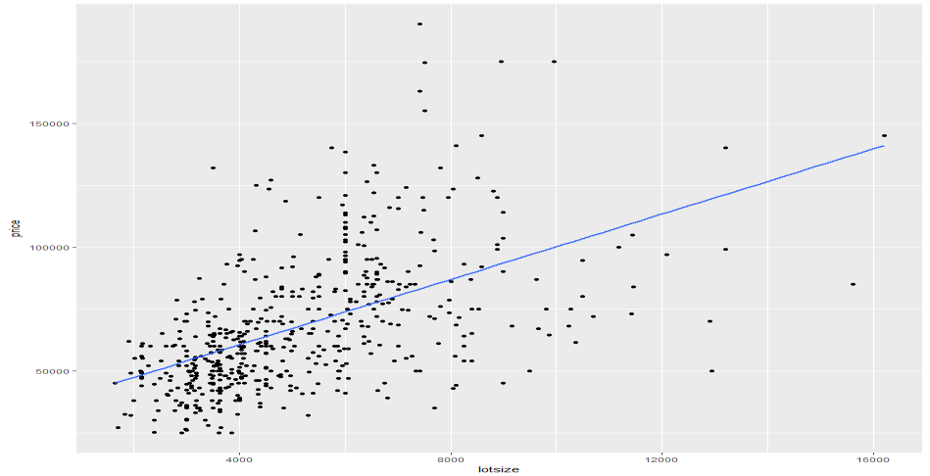
Scatter Plot
Scatter Plot of price (y) against lotsize (x), including the linear regression line
price
lotsize

Slide 17
Quiz (True/False)
The mean of a variable that has a right-skewed distribution is smaller than the median.
Answer: FALSE.
The correlation coefficient can capture the strength of both linear and non- linear relationships.
Answer: FALSE.

Slide 18

Data Analytics in Business
Linear Regression
Sridhar Narasimhan, Ph.D
Professor
Scheller College of Business
Notation

Slide 19
Linear Regression: Notation
Notation
Meaning
i = 1,2,…,n
i refers to the ith observation or record in a data set of records (typically a sample of the population)
(x₁₁, x₂₁, …, x_{p1}),
(x₁₂, x₂₂, …, x_{p2}),
…,
(x_{1n}, x_{2n}, …, x_{pn})
n observations of the p explanatory variables
y₁,y₂,…, y_{n}
n observations of the dependent variable
𝑦ത
Mean value of the dependent (y) variable
𝑥ҧ_{k}
Mean value of the x_{k}th explanatory (independent) variable

Slide 20
Linear Regression: Notation (cont’d)
Notation
Meaning
β₀, β₁,…, β_{p}
Parameters of the regression line for the entire population
b₀, b₁…, b_{p}
Estimates of the β parameters obtained by fitting the regression to the sample data
ε_{i}
e_{i}
Error term for the ith observation in the population
Error term for the ith observation in the sample
𝑦ො_{𝑖}
Estimated value of y for the ith observation in a sample. This is obtained by evaluating the regression function at x_{i}

Slide 21
Simple Linear Regression
We observe the data in the Housing dataset (which is a sample)
We want to build a model for the population:
Y_{i} = β₀ + β₁X_{i} + ε_{i} (which is the valid relation)
ε_{i} are independent and identically distributed (i.i.d.) random variables, which are normally distributed with mean 0 and standard deviation σ
However, we do not know β₀ , β₁ , or σ; so we need to estimate them based on the sample in the Housing dataset
Using this sample, we are going to build a model
Y_{i} = b₀ + b₁X_{i} + e_{i}

Slide 22


Population model, Y_{i} = β₀ + β₁X_{i} + ε_{i}
β₁Δx
•
Δx
•
Dependent variable, y
price
E(y) = β₀ + β₁x
•
•
•
• •
•
•
ε_{i} = N(0,σ)
•
•
β₀
lotsize
Independent variable, x

Slide 23
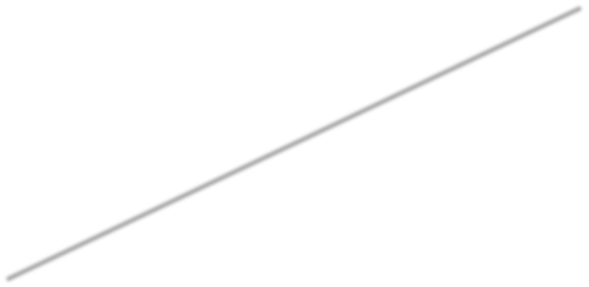
Estimates of Slope and Intercept Depend on the Sample Being Used
•
Sample A
•
•
price
•
•
•
lotsize

Slide 24

Estimates of Slope and Intercept Depend on
the Sample Being Used
•
•
Sample B
Sample A
••
•
•
price
•
•
•
lotsize

Slide 25
Use Ordinary Least Squares (OLS) to Fit the Line 𝑦ො = 𝑏₀ + 𝑏₁x
•
•
•
price
•
•
•
lotsize

Slide 26
Use Ordinary Least Squares (OLS) to Fit the
Line 𝑦ො = 𝑏₀ + 𝑏₁x
•
•
•
𝑦ത
price
•
•
•
lotsize

Slide 27
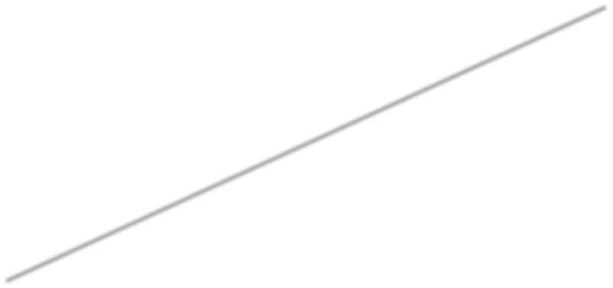
Use Ordinary Least Squares (OLS) to Fit the Line 𝑦ො = 𝑏₀ + 𝑏₁x
•
•
•
𝑦ത
price
•
•
b₀
•
lotsize

Slide 28
Use Ordinary Least Squares (OLS) to Fit the
Line 𝑦ො = 𝑏₀ + 𝑏₁x
𝑦ො = 𝑏₀ + 𝑏₁x
•
•
•
𝑦ത
b₁Δ_{x}
price
•
Δx
•
b₀
•
lotsize

Slide 29
Total Deviation = Explained Deviation + Unexplained Deviation
𝑦ො = 𝑏₀ + 𝑏₁x
price
•
•
•
𝑦ത
•
Predicted value, 𝑦ො_{𝑖}
•
^{𝑦}𝑖 *
•
Actual sale price, 𝑦_{𝑖}
(𝑥_{𝑖}, 𝑦_{𝑖})
•
(x=0, y = b₀)
•
_{𝑥}* _{𝑖}
lotsize

Slide 30
Total Deviation = Explained Deviation +
Unexplained Deviation
𝑦ො = 𝑏₀ + 𝑏₁x
price
•
•
•
𝑦ത
Total Deviation
= 𝒚_{𝒊} − ഥ𝒚
•
Predicted value, 𝑦ො_{𝑖}
•
^{𝑦}𝑖 *
•
Actual sale price, 𝑦_{𝑖}
(𝑥_{𝑖}, 𝑦_{𝑖})
•
(x=0, y = b₀)
•
_{𝑥}* _{𝑖}
lotsize

Slide 31
Total Deviation = Explained Deviation + Unexplained Deviation
𝑦ො = 𝑏₀ + 𝑏₁x
price
•
•
•
𝑦ത
Explained deviation
Total Deviation
= 𝒚_{𝒊} − ഥ𝒚
= ෝ𝒚_{𝒊} − ഥ𝒚
•
Predicted value, 𝑦ො_{𝑖}
•
^{𝑦}𝑖 *
•
Actual sale price, 𝑦_{𝑖}
(𝑥_{𝑖}, 𝑦_{𝑖})
•
(x=0, y = b₀)
•
_{𝑥}* _{𝑖}
lotsize

Slide 32
Total Deviation = Explained Deviation +
Unexplained Deviation
𝑦ො = 𝑏₀ + 𝑏₁x
price
•
•
•
𝑦ത
Explained deviation
Total Deviation
= 𝒚_{𝒊} − ഥ𝒚
= ෝ𝒚_{𝒊} − ഥ𝒚
•
Predicted value, 𝑦ො_{𝑖}
•
Unexplained deviation/Error/Residual
= 𝒚_{𝒊} − ෝ𝒚_{𝒊}
^{𝑦}𝑖 *
•
Actual sale price, 𝑦_{𝑖}
(𝑥_{𝑖}, 𝑦_{𝑖})
•
(x=0, y = b₀)
•
_{𝑥}* _{𝑖}
lotsize

Slide 33
Quiz (True/False)
The total deviation at observation (x_{i} , y_{i} ) is Answer: TRUE
𝒚_{𝒊} − 𝒚ഥ.
In OLS, the estimates of slope and intercept do not depend on the sample being used.
Answer: FALSE

Slide 34
Data Analytics in Business
Linear Regression
Sridhar Narasimhan, Ph.D
Professor
Scheller College of Business
R², Adjusted R²

Slide 35
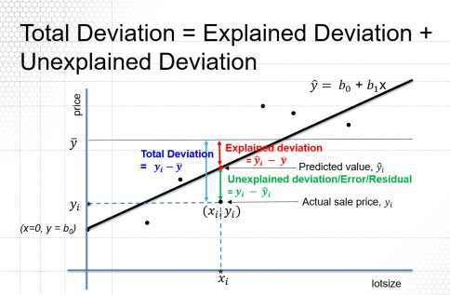
Regression (Ordinary Least Squares): Sum of Squared Errors (SSE)
Regression (OLS) determines the line that minimizes the Sum of Squared Errors
i.e., b₀ and b₁ are determined such that they minimize:
𝑺𝑺𝑬 = σ_{𝒊}(𝒚_{𝒊} − 𝒚ෝ_{𝒊})^{𝟐} = σ_{𝒊}(𝒚_{𝒊} − (𝒃_{𝟎} + 𝒃_{𝟏}𝒙_{𝒊}))^{𝟐}

Slide 36
Summing the Deviations
෍(𝑦_{𝑖} − 𝑦ത)²
𝑖
SST
Total Sum of Squares
෍(𝑦_{𝑖} − 𝑦ො_{𝑖})²
𝑖
SSE
Sum of Squared
Errors
෍(𝑦ത − 𝑦ො_{𝑖} )²
𝑖
SSR
Sum of Squares Regression
=
+
=
+
=
+

Slide 37
Regression Output R² and Adjusted R²
Coefficient of determination (R²)
A measure of the overall strength of the relationship between the dependent variable (Y) and independent variables (X)
R² = 1 – (SSE/SST) = SSR/SST
= Explained deviation (SSR)/Total Deviation (SST)
R² → how much of the variation in Y (from the mean) has been explained
Adjusted R²
Adding a penalty for the number of independent variables (p)
Adjusted R² = 1 – {SSE/(n – p – 1)}/{SST/(n – 1)}

Slide 38
_{R}2
•
• •
R² = 1,
X accounts for all Y variation
y
• •
• •
•
x
•
• • • • •
• • • • •
• •
R² = 0,
X accounts for none of the Y variation
y
x
• •
•
•
•
•
• •
•
•
R² = 0.75,
X accounts for most of the Y variation
•
•
y
•
x

Slide 39
Quiz (True/False)
R² = 0, implies that X values account for all of the variation in the Y values Answer: FALSE. R² = 0 implies that X values account for none of the
variation in the Y values
R² can take any value from – infinity to + infinity Answer: FALSE. It can take on values between 0 and 1

Slide 40
Data Analytics in Business
Linear Regression
Sridhar Narasimhan, Ph.D
Professor
Scheller College of Business
Simple Regression (One Predictor Variable) Using R

Slide 41
Regression Output: Simple Linear Regression
lm(formula = price ~ lotsize, data = Housing)
Residuals:
Min 1Q
-69551 -14626
Median 3Q
-2858 9752.
Max 106901
Unexplained deviation/Error/Residual
= 𝒚_{𝒊} − ෝ𝒚_{𝒊}
Coefficients:
Estimate 3.414e+04
6.599e+00
Std. Error 2.491e+03 13.7
4.458e-01 14.8
t value
<2e-16 ***
<2e-16 ***
Pr(>|t|)
(Intercept) lotsize
---
Signif. codes: 0 ‘***’ 0.001 ‘**’ 0.01 ‘*’ 0.05 ‘.’ 0.1 ‘ ’ 1
Residual standard error: 22570 on 544 degrees of freedom Multiple R-squared: 0.2871, Adjusted R-squared: 0.2858 F-statistic: 219.1 on 1 and 544 DF, p-value: < 2.2e-16

Slide 42
Regression Output: Coefficients
b₀ and b₁ are estimates of the true parameters β₀ and β₁
H₀: the parameter is zero, H₁: The parameter is not zero
lm(formula = price ~ lotsize, data = Housing)
Residuals:
Min 1Q
-69551 -14626
Median 3Q
-2858 9752
Max 106901
Coefficients:
Estimate 3.414e+04
6.599e+00
Std. Error 2.491e+03
4.458e-01
t value 13.7
14.8
Pr(>|t|)
<2e-16 ***
<2e-16 ***
(Intercept) lotsize
---
Signif. codes: 0 ‘***’ 0.001 ‘**’ 0.01 ‘*’ 0.05 ‘.’ 0.1 ‘ ’ 1
Residual standard error: 22570 on 544 degrees of freedom Multiple R-squared: 0.2871, Adjusted R-squared: 0.2858 F-statistic: 219.1 on 1 and 544 DF, p-value: < 2.2e-16

Slide 43
Regression Output: t-values for Coefficients
p value: the probability of finding a t value of this size if the null hypothesis is true H₀: the parameter is zero
lm(formula = price ~ lotsize, data = Housing)
Residuals:
Min 1Q
-69551 -14626
Median 3Q
-2858 9752
Max 106901
Coefficients:
Estimate 3.414e+04
6.599e+00
Std. Error 2.491e+03
4.458e-01
t value 13.7
14.8
Pr(>|t|)
<2e-16 ***
<2e-16 ***
(Intercept) lotsize
---
Signif. codes: 0 ‘***’ 0.001 ‘**’ 0.01 ‘*’ 0.05 ‘.’ 0.1 ‘ ’ 1
Residual standard error: 22570 on 544 degrees of freedom Multiple R-squared: 0.2871, Adjusted R-squared: 0.2858 F-statistic: 219.1 on 1 and 544 DF, p-value: < 2.2e-16

Slide 44
Interpreting Coefficients
Estimate
3.414e+04 ***
6.599e+00 ***
(Intercept) lotsize
b₀ = 34,140
Intercept of the regression line with the y-axis (when lotsize is zero). Not useful
b₁ = 6.599
An increase of 1,000 square feet is associated with an increase of the sale price
of a house by $6,599, keeping all else constant (ceteris paribus)

Slide 45
Regression Output: Sum of Squares
Analysis of Variance Table
 | Df | Sum Sq
lotsize | 1 | 1.1156e+11
Residuals | 544 | 2.7704e+11
SSR = 1.1156e+11
SSE = 2.7704e+11
SST = SSR + SSE = 3.886e+11

Slide 46
Regression Output: R²
lm(formula = price ~ lotsize, data = Housing)
Residuals: Min 1Q
-69551 -14626
Median
-2858
3Q Max 9752 106901
Coefficients:
Estimate
Std. Error t value
Pr(>|t|)
(Intercept) lotsize
---
3.414e+04
6.599e+00
2.491e+03
4.458e-01
13.7
14.8
<2e-16 ***
<2e-16 ***
Signif. codes: 0 ‘***’ 0.001 ‘**’ 0.01 ‘*’ 0.05 ‘.’ 0.1 ‘ ’ 1
Residual standard error: 22570 on 544 degrees of freedom
Multiple R-squared: 0.2871, Adjusted R-squared: 0.2858 F-statistic: 219.1 on 1 and 544 DF, p-value: < 2.2e-16

Slide 47
Regression Output R² and Adjusted R²
SSR = 1.1156e+11 SSE = 2.7704e+11
SST = SSR + SSE = 3.886e+11
Multiple R-squared: 0.2871, Adjusted R-squared: 0.2858 R² = 1 – (SSE/SST) = SSR/SST = 1.1156e+11/3.886e+11
= 0.2871
Note: 𝑅² = 0.2871 = 0.536 (which is the correlation coefficient between price and lotsize)
Adjusted R² = 1 – {SSE/(n – p – 1)}/{SST/(n – 1)}
= 1 – {(2.7704e+11/(546 – 1 – 1)} / {3.886e+11/(546 – 1)}
= 0.2858

Slide 48
F-test that the model is significant
(H₀: b₁ = 0)
SSR = 1.1156e+11
SSE = 2.7704e+11
SST = SSR + SSE = 3.886e+11
If p is the number of independent variables, The F statistic
= (SSR/p)/ (SSE/n – p – 1) = (R²/p) / (1 – R²)/(n – p – 1)
The value of Prob(F) is the probability that H₀ is true (i.e., b₁ = 0). For this model, p = 1,
F = (0.2871/1) / (1 – 0.2871)/(546 – 1 – 1) = 219.1
with (1,544) degrees of freedom.
F statistic: 219.1 with(1, 544) DF, p-value: < 2.2e-16. Hence H₀ is rejected.

